Slide 1
Slumdog Millionaire: June 5 Lecture
Part 1: Impact of Free Market Deregulation on India’s Poor
By Dr. Chowdhury

Slide 2
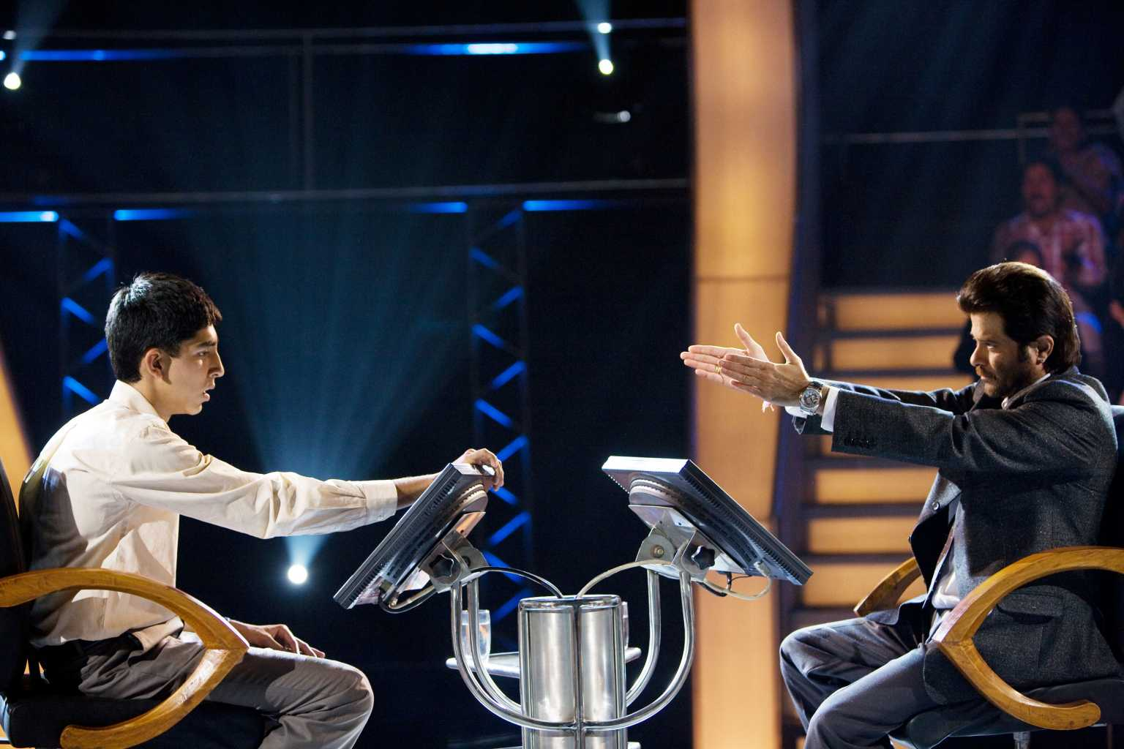
For Starters
What kind of influence do you think the hugely popular American TV show entitled Who wants to be a Millionaire has on Indians as shown in the film? Mostly positive? Mostly negative? Why?

Slide 3
1990s
India abandons socialism in favor of “free market”
Adapts IMF, World Bank, G8 economic recipe
“The Great Gatsby Curve”
High income inequality=high social immobility (as cited in Paul Krugman, “How Fares the American Dream”)

Slide 4
India 2000s
A newly rich class—a small percentage of a huge population
TV & Social Media fuels “upscale emulation” (Juliet Schor, The Overspent American)
A huge number of educated unemployed youth

Slide 5
Call Centre Jobs: One Symptom
What kind of training do the Call Centre Worker’s receive in the film?

Slide 6
Answers
Sketchy, hasty
Based on knowledge of UK pop/celebrity culture and touristic trivia
Even the “Chai Wallah” knows the answers

Slide 7
Discussion Topic
What seems to be the goal set for these young workers?

Slide 8
Answers
Sell unwanted products
“Family and friends upgrades”
Jamal’s awkward attempt to sell to a Scottish lady

Slide 9
Another Topic
How is it significant that the only thing Jamal can say when he finally tracks Salim down is the sales pitch?

Slide 10
Answers
Even family relationship has become commercialized
Compare with Prem’s aside that Jamal must have the kind brother who skips when Jamal needs help to answer the final question
Jamal is being ironic

Slide 11
More Topics
What is the work atmosphere like?

Slide 12
Answers
Constant monitoring and harassment
Cutting corner on safety and health regulations
“No filming” says a staff outside the building
Compare with police officer’s comment about Amnesty International

Slide 13
Another One
Why does one of the workers pressure Jamal to fill in for him so that he can become a contestant in the TV show?

Slide 14
Answers
An escape from sordid reality
Recall Latika’s statement

Slide 15
Another
What advice Jamal give to a frustrated young man trying to get in to the show?
Where did he himself get the info from?
What does the source reveal about the pool of young workers in the call centre?

Slide 16
Answers
Call when Prem says “if”
Knows because young man who worked on software now works in call center
Over qualified young man working in call center

Slide 17
The Two Indias
What is the difference between the “romantic India” Jamal shows the European couple and the “real India” he shows the American couple later?
What does Jamal show the US couple at first?
What does he refer to as the “real India” that he claims to have shown them?
Is one more “real” than the other? Why or why not?

Slide 18
Romantic? Really?
India “selling” it’s romanticized past to Western tourists
A lovelorn Indian emperor and his tribute to beloved wife
Jamal’s blatantly false rendition is both humorous and ironic

Slide 19
Answers
First shows a gigantic open-air laundry operation
Labor intensive hand washing employing thousands of underpaid workers
Environmentally polluting
Damaging to human health
Second, refers to the “car-stripping” by Salim’s gang as “real” India
Salim refers to Schumacher

Slide 20
More Answers
American couple-affectionate, humane
Yet uses money to make things alright-very American!
Overall, the whole scene seems practiced & contrived
Both are equally real and false at the same time
Appearance vs reality: an important theme

Slide 21
“Hard-Working” Jobs are Dead End but Scamming Pays
Jamal & Salim work as kitchen help in a diner
Salim regrets letting Jamal talk him into it
Fills an empty bottle with tap water to fill an order for mineral water
The tourist-scamming job lucrative & exciting

